Slide 1
Chapter 7:
Advanced SQL
Modern Database Management
10th Edition
Jeffrey A. Hoffer, V. Ramesh,
Heikki Topi
© 2011 Pearson Education, Inc. Publishing as Prentice Hall

Slide 2
Objectives
Write noncorrelated and correlated subqueries
Establish referential integrity in SQL
UNION to merge data sets
Conditional expressions
Notes:
Write noncorrelated and correlated subqueries – very commonly used in applications
Establish referential integrity in SQL
Understand triggers and stored procedures

Slide 3
Processing Multiple Tables
Using Subqueries
Subquery–placing an inner query (SELECT statement) inside an outer query
Options:
  In a condition of the WHERE clause
  As a “table” of the FROM clause
  Within the HAVING clause
  In the SELECT clause
Subqueries can be:
  Noncorrelated–executed once for the entire outer query
  Correlated–executed once for each row returned by the outer query
Notes:
We covered using join to process multiple tables. Another way is through use of subqueries.
Subquery is as the name suggests a query within the query.
Subquery can be placed in “
SELECT clause
FROM Caluse
HAVING clause
Two types:
Correlated – needs a link between the outer query and the subquery -> executes for each row returned in the query
Non-correlated – there is on inner link in the subquery. Executes once

Slide 4
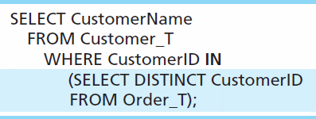
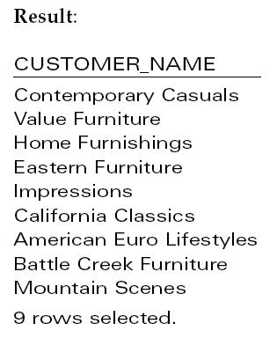
Subquery Example
Show all customers who have placed an order
The IN operator will test to see if the CUSTOMER_ID value of a row is included in the list returned from the subquery
Subquery is embedded in parentheses. In this case it returns a list that will be used in the WHERE clause of the outer query
Notes:
Subquery is what is in parenthesis.
In this example, the subquery can run by itself and return a result. Subquery is always in parenthesis
The subquery will return a list of all distinct or unique customer ID, and then that result is used to filter the outer query
This is a non-correlated subquery

Slide 5
Correlated vs. Noncorrelated Subqueries
Noncorrelated subqueries:
  Do not depend on data from the outer query
  Execute once for the entire outer query
Correlated subqueries:
  Make use of data from the outer query
  Execute once for each row of the outer query
  Can use the EXISTS operator
Notes:
Noncorrelated subqueries:
Do not depend on data from the outer query – just like we saw in the prior example the subquery could run by itself and you will see a list of customer ids
Execute once for the entire outer query – only executves
Correlated subqueries:
Make use of data from the outer query
Execute once for each row of the outer query

Slide 6
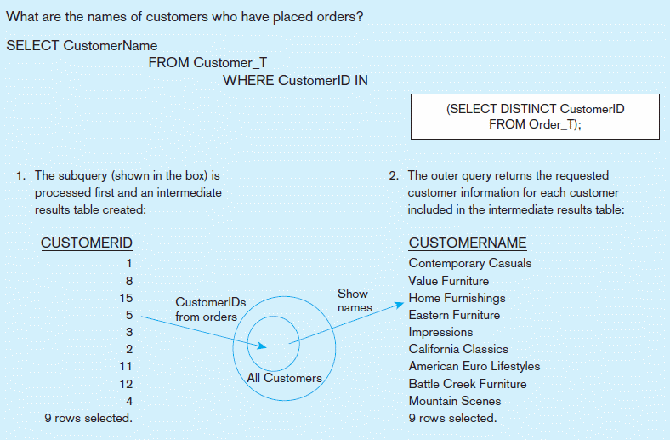
Figure 7-7a Processing a noncorrelated subquery
A noncorrelated subquery processes completely before the outer query begins
Notes:
1) The subquery is processed first, limiting the results from the query.
2) The outer query returns the requested results
RESULTs of subquery is used as filter on the outer query

Slide 7
Correlated Subquery Example
Show all orders that include furniture finished in natural ash
  SELECT DISTINCT OrderID FROM OrderLine_T
  WHERE EXISTS
  (SELECT * FROM Product_T
  WHERE ProductID = OrderLine_T.ProductID
  AND Productfinish = ‘Natural ash’);
The EXISTS operator will return a TRUE value if the subquery resulted in a non-empty set, otherwise it returns a FALSE
The subquery is testing for a value that comes from the outer query
➔ A correlated subquery always refers to an attribute from a table referenced in the outer query
Notes:
The EXISTS operator will return a TRUE if there is any result (non empty) , or a value of false if NOTHING was found. Empty result
A correlated subquery always refers to an attribute from a table referenced in the outer query. In this case ProductID
Matching fields from the outer query with fields from the subquery

Slide 8
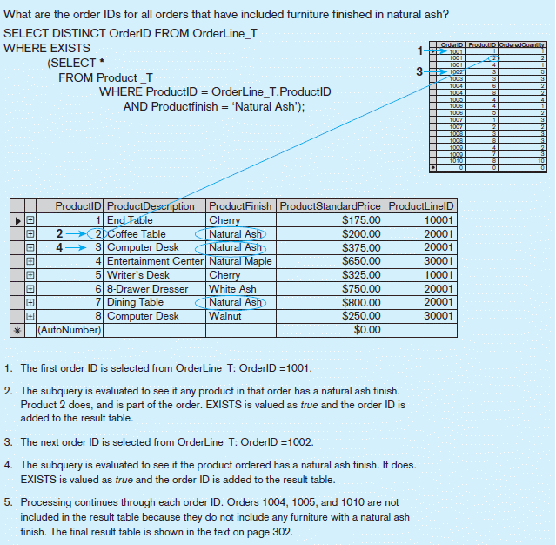
Figure 7-7b Processing a correlated subquery
Subquery refers to outer-query data, so executes once for each row of outer query
Note: only the orders that involve products with Natural Ash will be included in the final results
Notes:
Processing of correlated subquery is a bit different than non-correlated!
The first order is selected from the orderline_T table.
The subquery is evaluated for that order with ash finish. The exists would evaluate if true or false.
These gets repeated for all records in the outer query

Slide 9
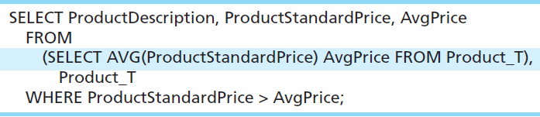
Another Subquery Example
Show all products whose standard price is higher than the average price
One column of the subquery is an aggregate function that has an alias name. That alias can then be referred to in the outer query
Subquery forms the derived table used in the FROM clause of the outer query
The WHERE clause normally cannot include aggregate functions, but because the aggregate is performed in the subquery its result can be used in the outer query’s WHERE clause
Notes:
In this query the subquery is in the FROM clause – this forms a derived table…
Average price is an alias of the aggregate function Now we can filter by it

Slide 10
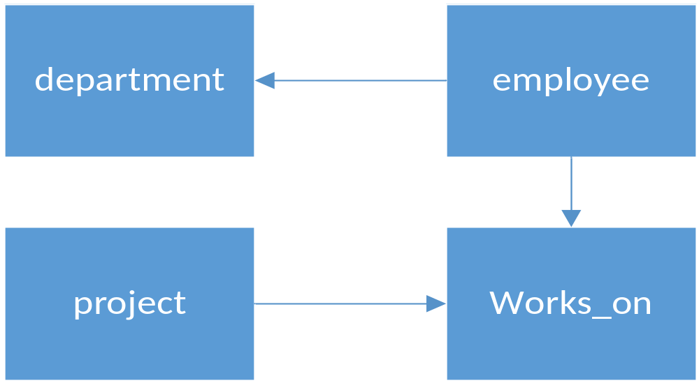
Subquery Exercise 1: from sample db
Using subquery, write a SQL query to return employee names (first and last) with at least one project.
Notes:
SELECT e.emp_fname, e.emp_lname
FROM employee e
where e.emp_no IN
( select w.emp_no
FROM works_on w
)

Slide 11
Subquery Exercise 2: from sample db
INSERT INTO works_on values ( 15000, 'p2', 'SQL Developer', '2019-02-01')
Create the records above. Using subquery, write a SQL query to return employee names (first and last) with at least two jobs.
Notes:
SELECT e.emp_fname, e.emp_lname
FROM employee e
where e.emp_no IN
(
select w.emp_no
from works_on w
group by emp_no
having count(*) >1
)

Slide 12
Subquery Exercise 3: from sample db
Using subquery, write a SQL query to return employee names (first and last) with NO projects.
Notes:
SELECT e.emp_fname, e.emp_lname
FROM employee e
where NOT EXISTS
(
select 1
from works_on w
WHERE e.emp_no = w.emp_no
)

Slide 13
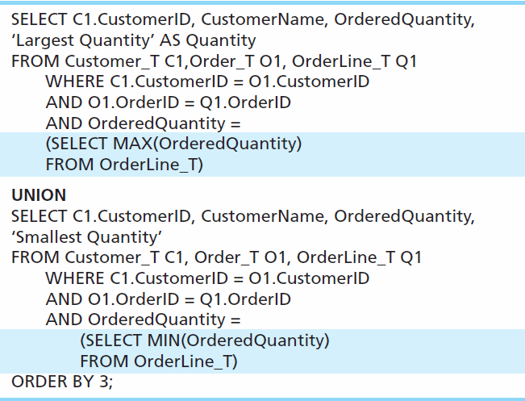
Union Queries
Combine the output (union of multiple queries) together into a single result table ( NO DUPS
First query
Combine
Second query
Notes:
UNION is used to combined output of multiple queries. Several times instead of writing one complicated query, it is easier and more readable to write two queries and combine the results.
That’s what union does

Slide 14
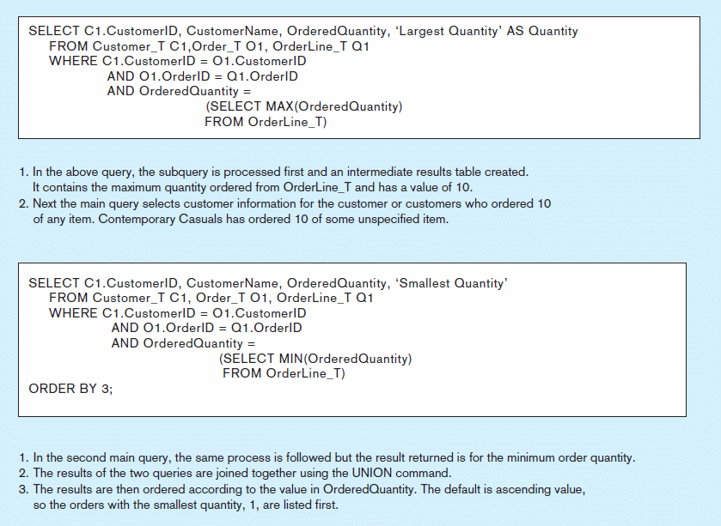
Figure 7-8 Combining queries using UNION
Note: with UNION queries, the quantity and data types of the attributes in the SELECT clauses of both queries must be identical
Notes:
When you union,
Data Types need to match, and the number of fields also have to match

Slide 15
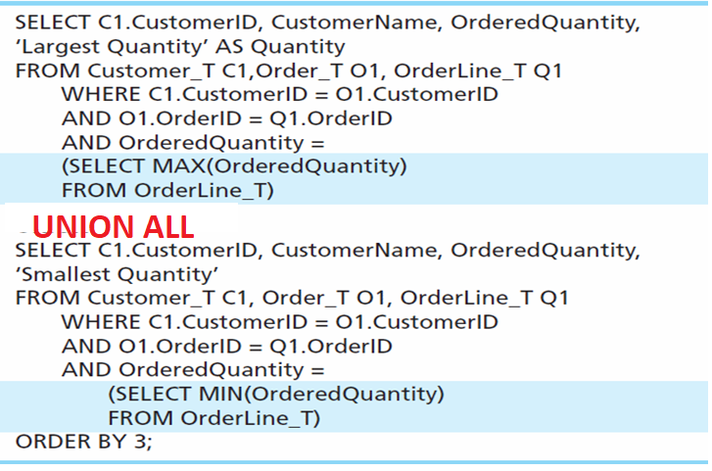
Union ALL Queries
Combine the output (union of multiple queries) together into a single result table ( WITH DUPS)
First query
Combine
Second query

Slide 16
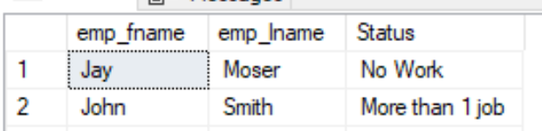
Union Exercise 1: example from previous lecture
Write a SQL query to return only employee names (first and last) with NO project and employees with more than 1 projects. Include the following fields:
Notes:
SELECT e.emp_fname, e.emp_lname, 'No Work' As Status
FROM employee e
where NOT EXISTS
(
select 1
from works_on w
WHERE e.emp_no = w.emp_no
)
union
SELECT e.emp_fname, e.emp_lname, 'More than 1 job' AS Status
FROM employee e
where e.emp_no IN
(
select w.emp_no
from works_on w
group by emp_no
having count(*) >1
)

Slide 17
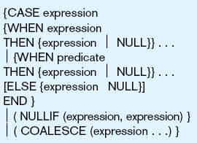
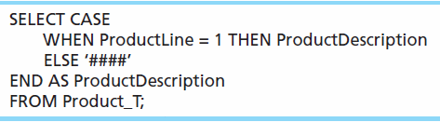
Conditional Expressions Using Case Syntax
This is available with newer versions of SQL, previously not part of the standard
Figure 7-9
Notes:
When the values from the DB is not stored exactly how you want to present, but the data could be derived or manipulated, using CASE WHEN ELSE

Slide 18
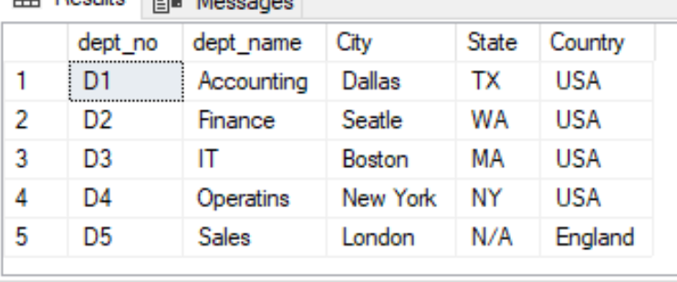
Try it!!! Conditional Expressions
Using sample db, create a SQL that returns the following results from department
Notes:
When the values from the DB is not stored exactly how you want to present, but the data could be derived , using CASE WHEN ELSE
select dept_no, dept_name,
location as City,
case [location] when 'Dallas' THEN 'TX'
WHEN 'Seatle' THEN 'WA'
WHEN 'Boston' then 'MA'
When 'New York' then 'NY'
else 'N/A' end as State,
case [location] when 'London' then 'England'
else 'USA' end as Country
from [dbo].[department]

Slide 19
Tips for Developing Queries
Be familiar with the data model (entities and relationships)
Understand the desired results
Identify the entities that contain desired attributes
Fine tune with GROUP BY and HAVING clauses if needed
Consider the effect on unusual data
Test, test, test
Notes:
Be familiar with the data model (entities and relationships)
Understand the desired results –
Know the attributes desired in result
Identify the entities that contain desired attributes
Review ERD
Construct a WHERE equality for each link
Fine tune with GROUP BY and HAVING clauses if needed
Consider the effect on unusual data

Slide 20
Query Efficiency Considerations
Instead of SELECT *, identify the specific attributes in the SELECT clause; this helps reduce network traffic of result set
Limit the number of subqueries; try to make everything done in a single query if possible
If data is to be used many times, make a separate query and store its results rather than performing the query repeatedly
Notes:
Instead of SELECT *, identify the specific attributes in the SELECT clause; this helps reduce network traffic of result set
Limit the number of subqueries; try to make everything done in a single query if possible
If data is to be used many times, make a separate query and store its results rather than performing the query repeatedly
We will cover some data structures that allows you to save the same once and reuse – temp tables, variable tables, CTE

Slide 21
Guidelines for Better Query Design
Understand how indexes are used in query processing
Use compatible data types for fields and literals
Write simple queries
Break complex queries into multiple simple parts
Don’t nest one query inside another query
Notes:
The whole point of indices is to speed up performance of query, use it wiseluy
We will cover optimizer statistics. M

Slide 22
Guidelines for Better Query Design (cont.)
Create temporary tables for groups of queries
Combine update operations
Retrieve only the data you need
Don’t have the DBMS sort without an index
Learn!
Consider the total query processing time for ad hoc queries

Slide 23
Data Dictionary Facilities
System tables that store metadata
Users usually can view some of these tables
Users are restricted from updating them
Some examples in Oracle 11g
  DBA_TABLES – descriptions of tables
  DBA_CONSTRAINTS – description of constraints
  DBA_USERS – information about the users of the system
Examples in Microsoft SQL Server 2008+
  sys.columns – table and column definitions
  sys.indexes – table index information
  sys.foreign_key_columns – details about columns in foreign key constraints
Notes:
Remove

